Slide 1
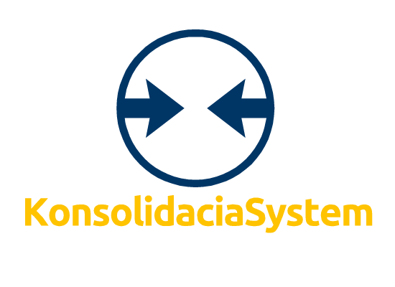
DATA CONSOLIDATOR

Slide 2
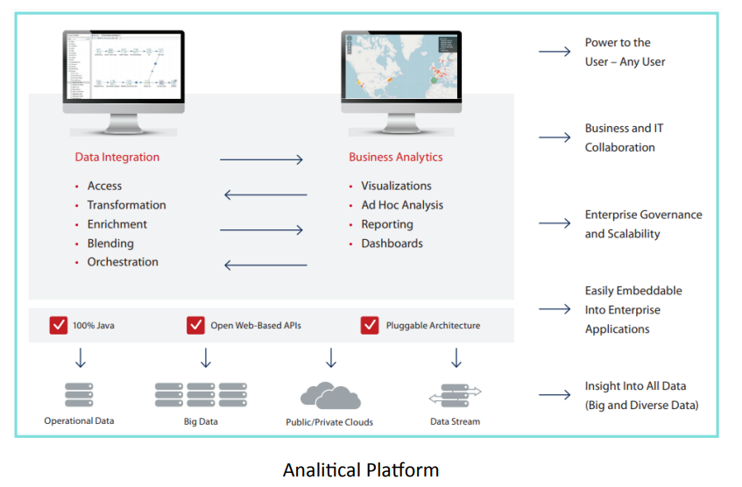

Slide 3
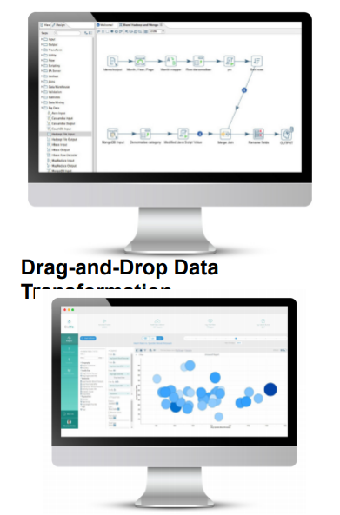
Data Integration
1.Organizations face challenges that the bigger it is to manage and extract value
of the variety and volume of data that grows in
the entire edge-to-cloud infrastructure. With
Conxoliatio, organizations can access
data from complex and heterogeneous
source and merge with data
relational existing to generate
high-quality information, ready for
analyzed all without writing a line
code.
2. Rich graphical user interface
Paired with a powerful engine
multithreaded transformation offers
High performance ETL(extraction,
transformation and loading) which includes
all data integration needs, including
big data consumption and processing

Slide 4
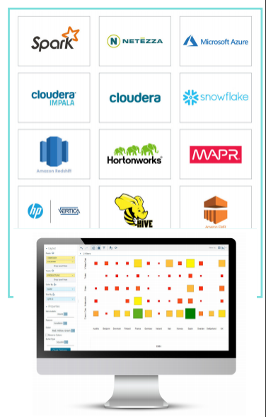
FEATURES
-Innovative drag-and-drop interface to simplify analytics creation
-Extensive connectivity to almost all data sources, whether on-premises or in the cloud, including files, RDBMS, APIs and other sources.
-Integration with transactional databases, including Oracle,IBM,DB2, Postgresql, Mysql -and More.
-access to data in enterprise applications, including SAP, Google Analytics and others.
-Direct access to full analytics, including graphing, visualization and reporting of each extraction step
-Strong orchestration capabilities to coordinate complex workflows, including scheduling and alerts.
-Integration of advanced analytical models from R, Python, Scala.
-Weka that combines libraries, such as scikit-learn, Spark MLlib, into the data stream.

